Slide 1
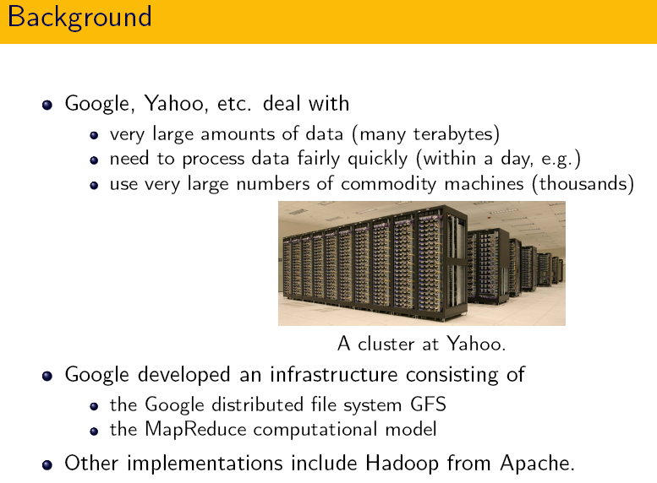
Map-Reduce framework

Slide 2
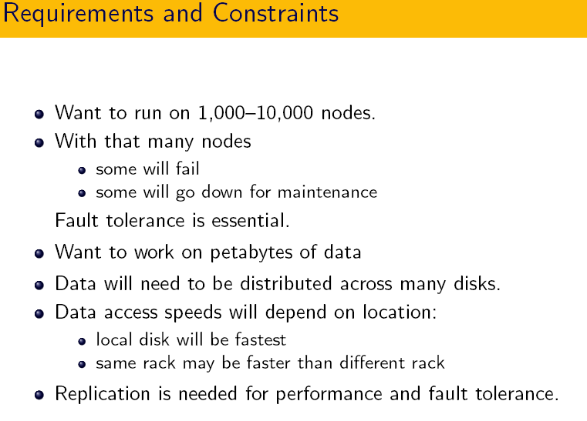

Slide 3
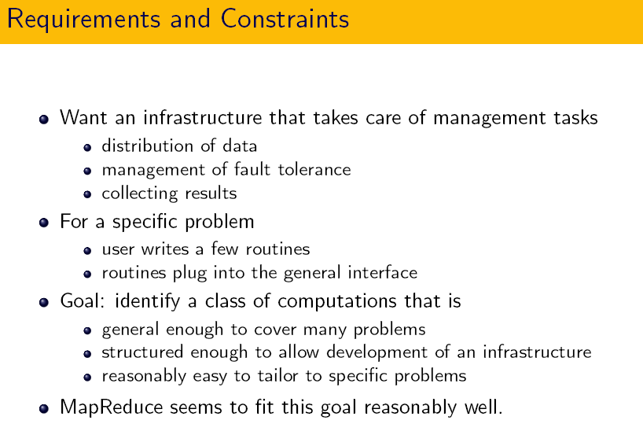

Slide 4
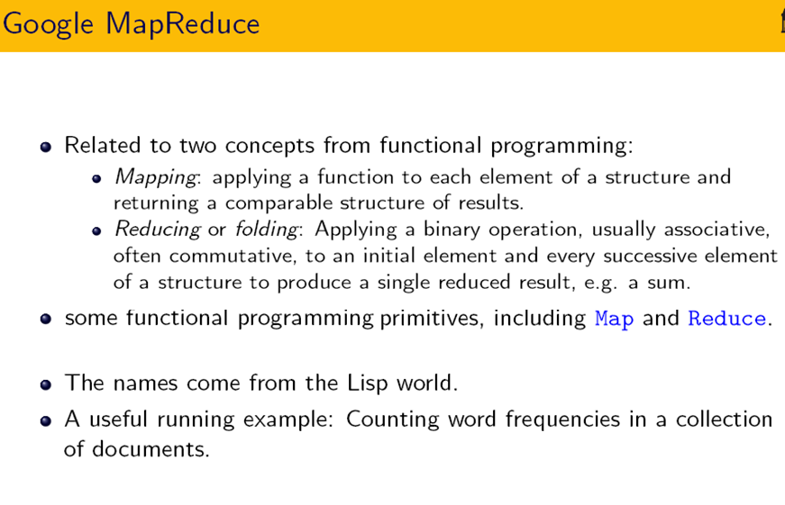

Slide 5
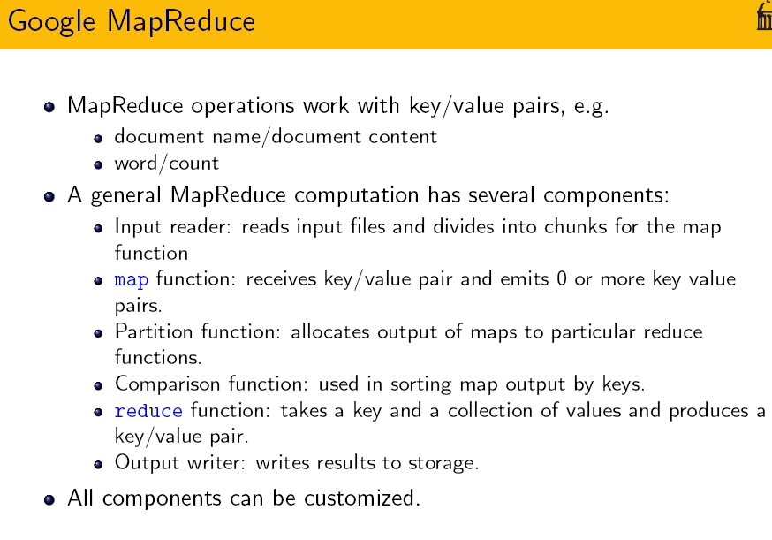

Slide 6
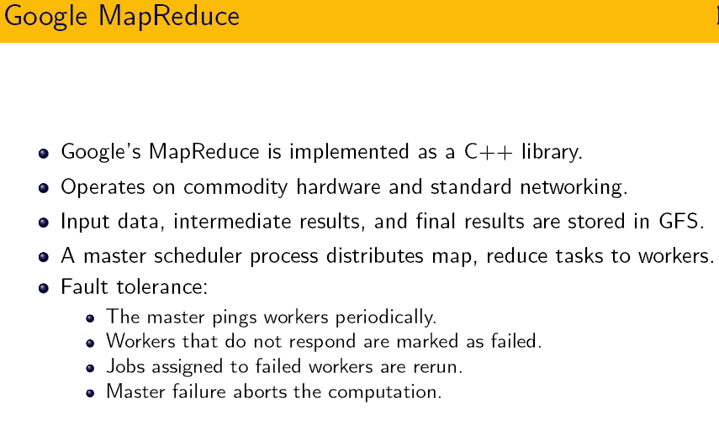

Slide 7
Introduction
Map-Reduce is a programming model designed for processing large volumes of data in parallel by dividing the work into a set of independent tasks.
Map-Reduce programs are written in a particular style influenced by functional programming constructs, specifically idioms for processing lists of data.
This module explains the nature of this programming model and how it can be used to write programs which run in the Hadoop environment.

Slide 8
Map-reduce Basics
1. List Processing
Conceptually, Map-Reduce programs transform lists of input data elements into lists of output data elements.
A Map-Reduce program will do this twice, using two different list processing idioms: map, and reduce.
These terms are taken from several list processing languages such as LISP, Scheme, or ML

Slide 9
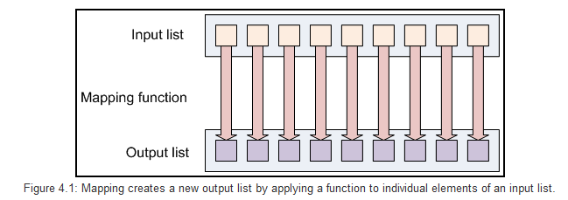
Map-reduce Basics
2.Mapping Lists
The first phase of a Map-Reduce program is called mapping.
A list of data elements are provided, one at a time, to a function called the Mapper, which transforms each element individually to an output data element.

Slide 10
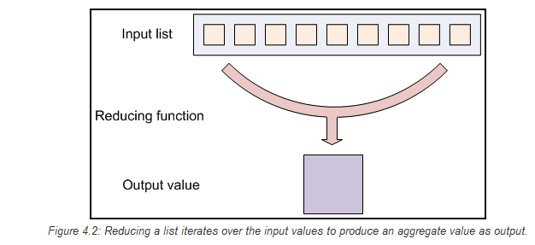
Map-reduce Basics
3.Reducing List
Reducing lets you aggregate values together.
A reducer function receives an iterator of input values from an input list.
It then combines these values together, returning a single output value.

Slide 11
Map-reduce Basics
4.Putting Them Together in Map-Reduce:
The Hadoop Map-Reduce framework takes these concepts and uses them to process large volumes of information.
A Map-Reduce program has two components:
Mapper
And reducer.
The Mapper and Reducer idioms described above are extended slightly to work in this environment, but the basic principles are the same.

Slide 12
Example (word count)
mapper (filename, file-contents):
for each word in file-contents:
emit (word, 1)
reducer (word, values):
sum = 0
for each value in values:
sum = sum + value
emit (word, sum)

Slide 13
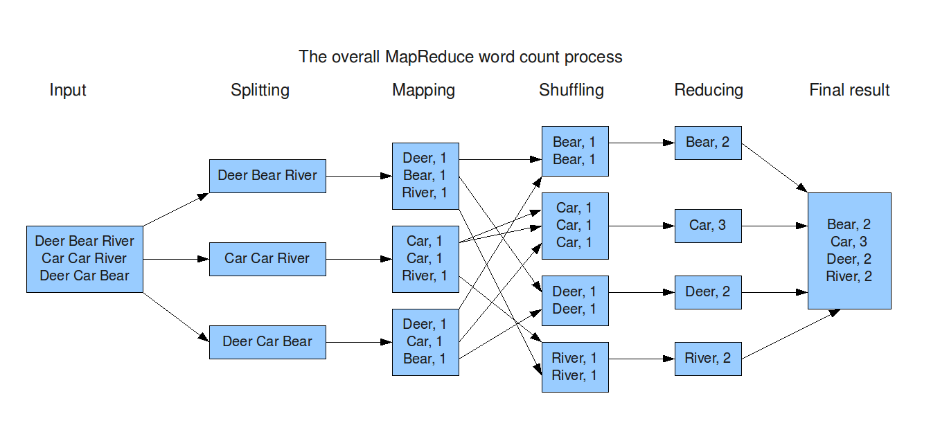
Example (word count)

Slide 14
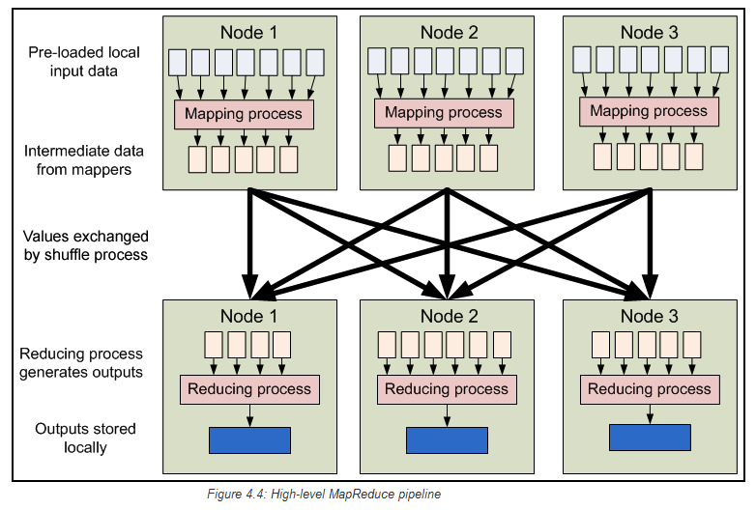
Map-Reduce Data Flow Now that we have seen the components that make up a basic MapReduce job, we can see how everything works together at a higher level:

Slide 15
Data flow
Map-Reduce inputs typically come from input files loaded onto our processing cluster in HDFS.
These files are distributed across all our nodes.
Running a Map-Reduce program involves running mapping tasks on many or all of the nodes in our cluster.
Each of these mapping tasks is equivalent:
no mappers have particular "identities" associated with them.
Therefore, any mapper can process any input file. Each mapper loads the set of files local to that machine and processes them.

Slide 16
Data flow
When the mapping phase has completed, the intermediate (key, value) pairs must be exchanged between machines to send all values with the same key to a single reducer.
The reduce tasks are spread across the same nodes in the cluster as the mappers.
This is the only communication step in MapReduce.
Individual map tasks do not exchange information with one another, nor are they aware of one another's existence.
Similarly, different reduce tasks do not communicate with one another.

Slide 17
Data flow
The user never explicitly marshals information from one machine to another; all data transfer is handled by the Hadoop Map-Reduce platform itself, guided implicitly by the different keys associated with values.
This is a fundamental element of Hadoop Map-Reduce's reliability.
If nodes in the cluster fail, tasks must be able to be restarted.
If they have been performing side-effects, e.g., communicating with the outside world, then the shared state must be restored in a restarted task.
By eliminating communication and side-effects, restarts can be handled more gracefully.

Slide 18
Input files
This is where the data for a Map-Reduce task is initially stored.
While this does not need to be the case, the input files typically reside in HDFS.
The format of these files is arbitrary; while line-based log files can be used, we could also use a binary format, multi-line input records, or something else entirely.
It is typical for these input files to be very large -- tens of gigabytes or more.

Slide 19
InputFormat
These input files are split up and read is defined by the InputFormat.
An InputFormat is a class that provides the following functionality:
Selects the files or other objects that should be used for input
Defines the InputSplits that break a file into tasks
Provides a factory for RecordReader objects that read the file
Several InputFormats are provided with Hadoop.
An abstract type is called FileInputFormat; all InputFormats that operate on files inherit functionality and properties from this class.
When starting a Hadoop job, FileInputFormat is provided with a path containing files to read.
The FileInputFormat will read all files in this directory. It then divides these files into one or more InputSplits each.
You can choose which InputFormat to apply to your input files for a job by calling the setInputFormat() method of the JobConf object that defines the job.

Slide 20
The default InputFormat is the TextInputFormat.
This is useful for unformatted data or line-based records like log files.
A more interesting input format is the KeyValueInputFormat.
This format also treats each line of input as a separate record. While the TextInputFormat treats the entire line as the value,
the KeyValueInputFormat breaks the line itself into the key and value by searching for a tab character.
This is particularly useful for reading the output of one MapReduce job as the input to another
Finally, the SequenceFileInputFormat reads special binary files that are specific to Hadoop.
These files include many features designed to allow data to be rapidly read into Hadoop mappers.
Sequence files are block-compressed and provide direct serialization and deserialization of several arbitrary data types (not just text).
Sequence files can be generated as the output of other MapReduce tasks and are an efficient intermediate representation for data that is passing from one MapReduce job to anther.

Slide 21
InputSplits
An InputSplit describes a unit of work that comprises a single map task in a MapReduce program.
A MapReduce program applied to a data set, collectively referred to as a Job, is made up of several (possibly several hundred) tasks.
Map tasks may involve reading a whole file; they often involve reading only part of a file.
By default, the FileInputFormat and its descendants break a file up into 64 MB chunks (the same size as blocks in HDFS).

Slide 22
RecordReader
The InputSplit has defined a slice of work, but does not describe how to access it.
The RecordReader class actually loads the data from its source and converts it into (key, value) pairs suitable for reading by the Mapper.
The RecordReader instance is defined by the InputFormat.
The default InputFormat, TextInputFormat, provides a
LineRecordReader, which treats each line of the input file as a new value.
The key associated with each line is its byte offset in the file.
The RecordReader is invoke repeatedly on the input until the entire InputSplit has been consumed. Each invocation of the RecordReader leads to another call to the map() method of the Mapper.

Slide 23
Mapper
The Mapper performs the interesting user-defined work of the first phase of the MapReduce program.
Given a key and a value, the map() method emits (key, value) pair(s) which are forwarded to the Reducers.
A new instance of Mapper is instantiated in a separate Java process for each map task (InputSplit) that makes up part of the total job input. The individual mappers are intentionally not provided with a mechanism to communicate with one another in any way.
This allows the reliability of each map task to be governed solely by the reliability of the local machine.
The map() method receives two parameters in addition to the key and the value:

Slide 24
Mapper
The OutputCollector object has a method named collect() which will forward a (key, value) pair to the reduce phase of the job.
The Reporter object provides information about the current task; its getInputSplit() method will return an object describing the current InputSplit.
It also allows the map task to provide additional information about its progress to the rest of the system.
The setStatus() method allows you to emit a status message back to the user. The incrCounter() method allows you to increment shared performance counters.
Each mapper can increment the counters, and the JobTracker will collect the increments made by the different processes and aggregate them for later retrieval when the job ends.

Slide 25
1.Partition & Shuffle (Mapper)
After the first map tasks have completed, the nodes may still be performing several more map tasks each.
But they also begin exchanging the intermediate outputs from the map tasks to where they are required by the reducers.
This process of moving map outputs to the reducers is known as shuffling.
A different subset of the intermediate key space is assigned to each reduce node; these subsets (known as "partitions") are the inputs to the reduce tasks.
Each map task may emit (key, value) pairs to any partition; all values for the same key are always reduced together regardless of which mapper is its origin.
Therefore, the map nodes must all agree on where to send the different pieces of the intermediate data.
The Partitioner class determines which partition a given (key, value) pair will go to.
The default partitioner computes a hash value for the key and assigns the partition based on this result.

Slide 26
2. Sort (Mapper)
Each reduce task is responsible for reducing the values associated with several intermediate keys.
The set of intermediate keys on a single node is automatically sorted by Hadoop before they are presented to the Reducer.

Slide 27
Reduce
A Reducer instance is created for each reduce task.
This is an instance of user-provided code that performs the second important phase of job-specific work.
For each key in the partition assigned to a Reducer, the Reducer's reduce() method is called once.
This receives a key as well as an iterator over all the values associated with the key.
The values associated with a key are returned by the iterator in an undefined order.
The Reducer also receives as parameters OutputCollector and Reporter objects; they are used in the same manner as in the map() method.

Slide 28
1. OutputFormat (Reducer)
The (key, value) pairs provided to this OutputCollector are then written to output files.
The way they are written is governed by the OutputFormat.
The OutputFormat functions much like the InputFormat class.
The instances of OutputFormat provided by Hadoop write to files on the local disk or in HDFS; they all inherit from a common FileOutputFormat.

Slide 29
2. RecordWriter (Reducer)
Much like how the InputFormat actually reads individual records through the RecordReader implementation, the OutputFormat class is a factory for RecordWriter objects; these are used to write the individual records to the files as directed by the OutputFormat.

Slide 30
3. Combiner (Reducer)
The pipeline showed earlier omits a processing step which can be used for optimizing bandwidth usage by MapReduce job.
Called the Combiner, this pass runs after the Mapper and before the Reducer.
Usage of the Combiner is optional. If this pass is suitable for your job, instances of the Combiner class are run on every node that has run map tasks.
The Combiner will receive as input all data emitted by the Mapper instances on a given node. The output from the Combiner is then sent to the Reducers, instead of the output from the Mappers.
The Combiner is a "mini-reduce" process which operates only on data generated by one machine.

Slide 31
More Tips about map-reduce
Chaining Jobs
Not every problem can be solved with a MapReduce program, but fewer still are those which can be solved with a single MapReduce job. Many problems can be solved with MapReduce, by writing several MapReduce steps which run in series to accomplish a goal:
E.g
Map1 -> Reduce1 -> Map2 -> Reduce2 -> Map3…

Slide 32
Listing and Killing Jobs:
It is possible to submit jobs to a Hadoop cluster which malfunction and send themselves into infinite loops or other problematic states.
In this case, you will want to manually kill the job you have started.
The following command, run in the Hadoop installation directory on a Hadoop cluster, will list all the current jobs:
$ bin/hadoop job -list
currently running JobId StartTime UserName job_200808111901_0001 1 1218506470390 aaron
$ bin/hadoop job -kill jobid

Slide 33
Conclusions
This module described the MapReduce execution platform at the heart of the Hadoop system. By using MapReduce, a high degree of parallelism can be achieved by applications.
The MapReduce framework provides a high degree of fault tolerance for applications running on it by limiting the communication which can occur between nodes, and requiring applications to be written in a "dataflow-centric" manner.

Slide 34
Assignment
Parallel efficiency of map-reduce.

Slide 35
Q&A/Feedback?

